Slide 1
Electronics dataset
15 Jan 2025

Slide 2
Summary Key Insights
Our analysis of the product orders dataset reveals several key insights that can guide strategic decisions. Firstly, the word cloud analysis indicates that Tablet and Keyboard are the most frequently ordered products, suggesting a high demand for these items. This insight can be leveraged to ensure adequate stock levels and possibly explore bulk purchasing discounts to reduce costs. Additionally, the price analysis shows that printers are priced significantly higher than other products, which could indicate a premium market segment. This suggests an opportunity to explore marketing strategies that highlight the value and features of these high-margin items to boost sales.
Furthermore, the data indicates that the quantity ordered has a noticeable effect on the types of products purchased. For instance, monitors are predominantly ordered in single units, while desks and external hard drives are often ordered in larger quantities. This pattern suggests that customers may be purchasing monitors for individual use and desks or storage devices for office setups. Understanding these purchasing behaviors can help tailor marketing campaigns and promotions to target specific customer needs more effectively. For example, offering bundle deals for office furniture and storage devices could attract bulk buyers and increase overall sales.

Slide 3
Summary Key Insights
Lastly, while some differences in quantities ordered across product categories are not statistically significant due to small sample sizes, the general trends observed can still inform inventory management and sales strategies. Ensuring a balanced stock of high-demand items like tablets and keyboards, while also promoting higher-margin products like printers, can optimize both customer satisfaction and profitability. Running further statistical tests on these trends can provide more robust insights and help refine these strategies.

Slide 4
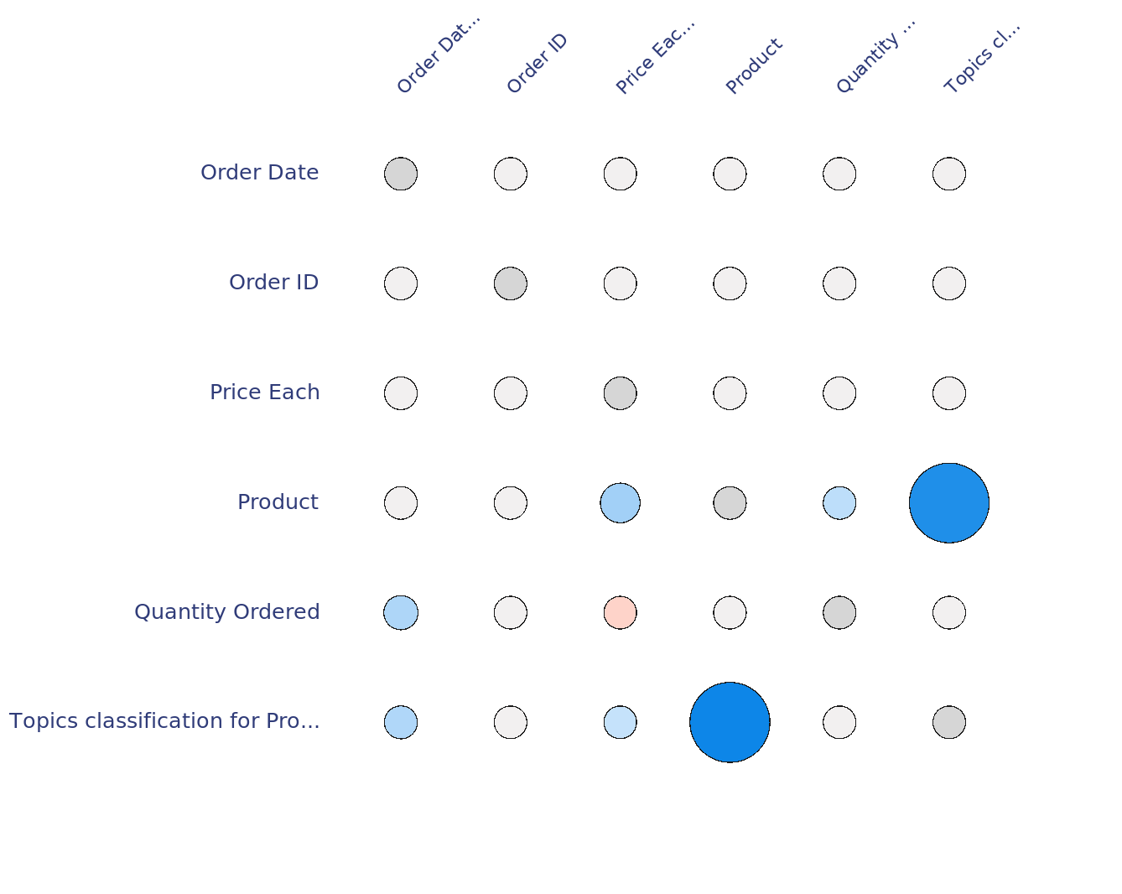
Product Topics Classification Predicts with 89% Accuracy
Predictive power from 0 (failure to predict) to 100 (perfect prediction) across columns
FIn-depth insight_x000C_ The data exhibits a strong relationship between &#34;Quantity Ordered&#34; and &#34;Order Date&#34; with a score of 1600. As a student, an interesting insight is that ordering behavior, represented by the quantity of products ordered, could be influenced by specific time periods or dates. For instance, ordering might increase in periods associated with discounts, holidays or semester beginnings. This relationship can be utilized for forecasting future inventory needs or sales promotions around high-demand periods.
Key takeaway: Since Product classification is a strong predictor, focusing on improving and refining Product categories could enhance sales predictions and inventory management.
■ | Positive relation | ■ | Categorical relation
■ | Negative relation | ■ | Negligible relation
Notes:
This matrix illustrates how well one column predicts another. It uses a Predictive Power Index (PPI) that can detect both linear and more complex relationships, expressed on a range from 0 (indicating failure to predict) to 100 (indicating perfect prediction).
The strength indices work both ways. For example, the Product column can fully predict Topics classification for Product with a score of 100, but the Topics classification for Product column has less ability to predict Product with a reversed score of 89.
The darker the square, the more meaningful the prediction. Darker squares thus tend to produce more meaningful charts. Moreover, the legend indicates both positive and negative correlations, whereas (dodgerblue-colored) shaded squares represent undetermined correlations due to unordered categories. Undetermined correlations usually occur if one of the columns has categories that have no logical order, such as, for example, Country, Gender, Eye color, and so on.

Slide 5
The dataset contains details about Product orders, including Order ID, Product name, Quantity Ordered, price per item, and Order Date. One key insight is that the classification of Products is a strong predictor for the Products themselves, with a Predictive Power Index of 89. This means that knowing the category of a Product can help us predict the specific Product with high accuracy.
Additionally, looking at how different categories relate to each Other (cross-correlation) can give us even more useful information. For example, if certain Products are often ordered together, this could help in planning promotions or managing inventory.
External Har. . . Storage Devi. . . strong positive
Tablet Computing De. . . strong positive
Headphones Audio Device. . . strong positive
Laptop Other strong positive
Monitor Display Devi. . . strong positive

Slide 6
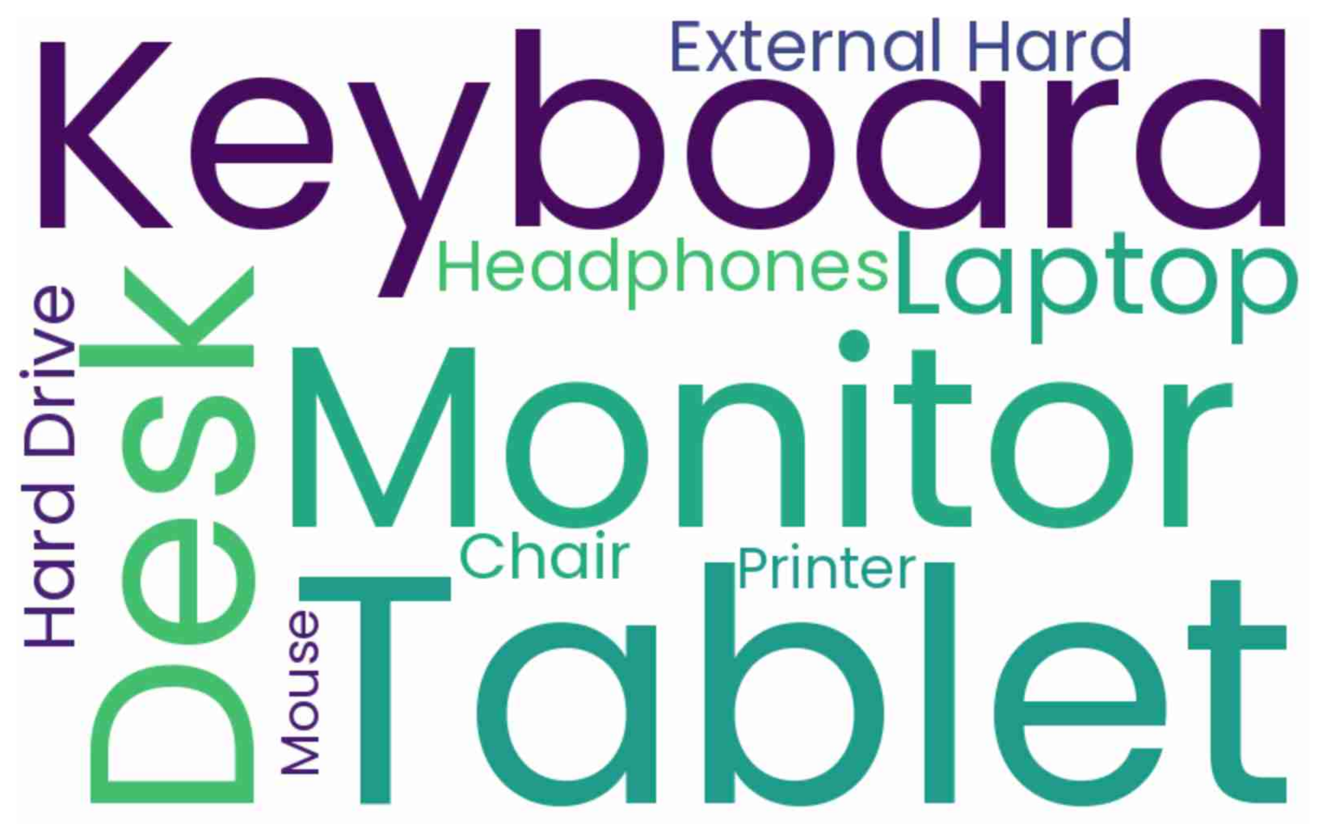
Key takeaway: Tablet, Keyboard, Monitor
Word cloud for Product
Key takeaway: Consider increasing the stock or promotional efforts for Tablets and Keyboards, as they are the most frequently ordered Products.
The word cloud shows that the most common Product ordered is Tablet, which appears 16 times. The next most common Product is Keyboard, appearing 13 times. This suggests that Tablets are the most popular item among customers, followed closely by Keyboards.
Tablet 1.0
Keyboard 0.81
Monitor 0.75
Desk 0.62
Laptop 0.62
Headphones 0.62
External Hard 0.62
Hard Drive 0.62
Chair 0.5
Printer 0.38
Mouse 0.31
Notes:
A word cloud is a visual representation of text data where the size of each word indicates its frequency or importance. Significant words or phrases often appear larger and bolder. It provides quick way to perceive the most important words from comments and free text.
For example, here for the question Product the most frequent word or phrases are Tablet, Keyboard, and Monitor

Slide 7
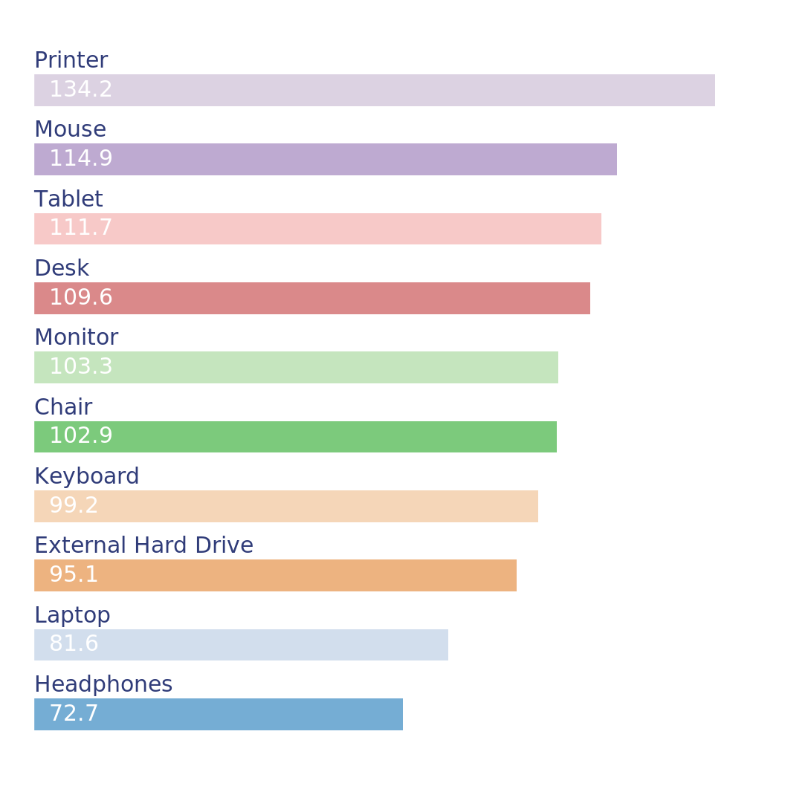
Printer Leads Price Each Rankings by Far
Top ten average values of Price Each by Product
The price of each Printer is much higher than the price of each Mouse and Other Products. This means that Printers are significantly more expensive compared to Other items in the dataset. If you are looking to increase revenue, focusing on selling more Printers could be a good strategy due to their higher price.
Notes:
This bar chart shows the ten highest values of Price Each which have been aggregated by Product by taking the average of of Price Each for each group. For each Product. The bars are arranged from the highest to the lowest Price Each.
For example, Printer has the highest value with 134.2.

Slide 8
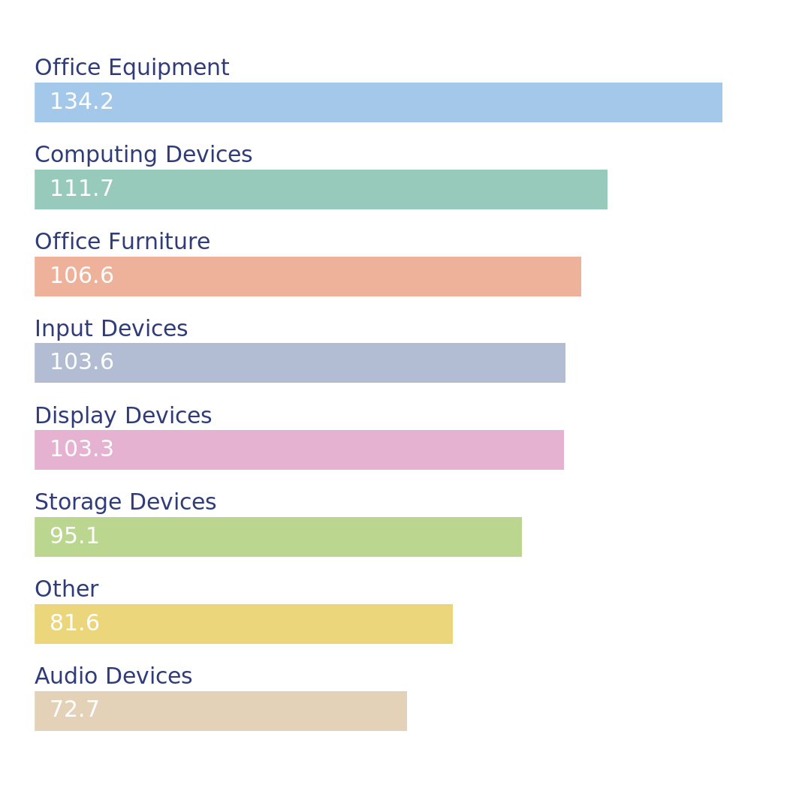
Office Equipment Leads Price Each Rankings
Top eight average values of Price Each by Topics classification . ..
Key takeaway: If you are looking to increase revenue, focusing on selling more Office Equipment could be beneficial due to their higher price points.
The price per item for Office Equipment is significantly higher than that of Computing Devices and Other Product categories. This means that Office Equipment tends to be more expensive compared to Other types of Products in the dataset.
Notes:
This bar chart shows the eight highest values of Price Each which have been aggregated by Topics classification for Product by taking the average of of Price Each for each group. For each Topics classification for Product. The bars are arranged from the highest to the lowest Price Each.
For example, Office Equipment has the highest value with 134.2.

Slide 9
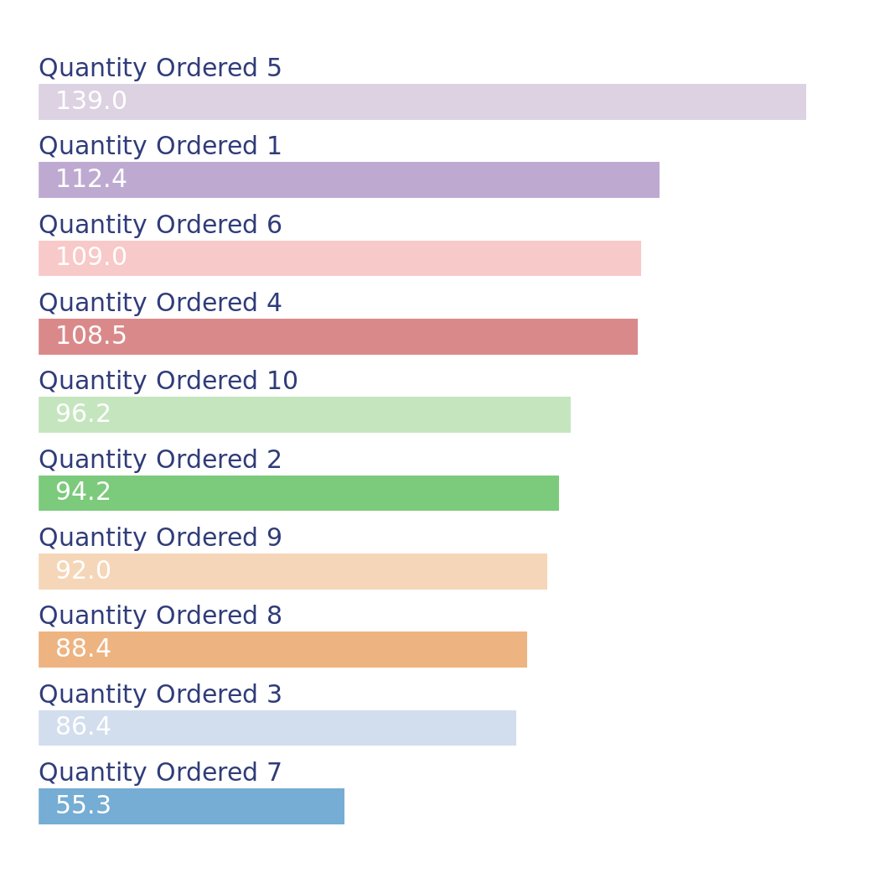
Key takeaway: Quantity Ordered 5 Dominates
Top ten average values of Price Each by Quantity Ordered
FIn-depth insight_x000C_ One potential insight from the data is that higher quantities ordered, such as 5, don';t necessarily lead to lower price per item. In fact, the average price for quantity 5 ordered is significantly higher than for other quantities. This could mean that when larger quantities are ordered, they are usually for more expensive items, perhaps due to bulk purchases of high-value products like laptops or other electronics. This peculiarity can be interesting to a student studying consumer buying behavior or pricing strategies.
Key takeaway: Consider promoting these high-value items more prominently, as they seem to be associated with higher prices and potentially higher profit margins.
Notes:
This bar chart shows the ten highest values of Price Each which have been aggregated by Quantity Ordered by taking the average of of Price Each for each group. For each Quantity Ordered. The bars are arranged from the highest to the lowest Price Each.
For example, 5 has the highest value with 139.0.

Slide 10
The Product with a Quantity Ordered of 5 has the highest price per item, significantly more expensive than Products with a Quantity Ordered of 1 and Other quantities. This suggests that items ordered in larger quantities might be premium or high-value Products.

